Slide 1


Stock Price Prediction System
Building a robust forecasting model using Machine Learning, Time Series Analysis, and Technical Indicators.
Notes:
1

Slide 2


Project Objectives
Our system is designed to address the challenge of stock market volatility by integrating multiple analytical methods.
Data Collection & Preprocessing
Model Implementation
Implement and compare Linear Regression, Random Forest, Decision Tree, and ARIMA models.
Fetch real-time stock data (yfinance) and compute technical indicators (RSI).
Evaluation & Visualization
Evaluate performance using R² Score and visualize predictions/RSI on a web application.
Notes:
2

Slide 3




Core Technology Stack
A blend of powerful Python libraries and a lightweight web framework ensures efficient data processing and deployment.
Python
Libraries
Primary programming language for all backend logic and model training.
Pandas, scikit-learn, statsmodels, and the 'ta' library for technical analysis.
Flask
Visualization
Used as the web framework for deploying the prediction system.
Matplotlib and Chart.js for interactive data and prediction displays.
Notes:
3

Slide 4






System Architecture Flow
The system follows a clear, six-step process from user input to final visualization.
User Input
Enter stock ticker (e.g., AAPL).
Data Collection
Fetch stock data via yfinance.
Feature Engineering
Compute RSI as an input feature.
Model Training
Train ML/ARIMA models.
Prediction
Forecast future stock prices.
Visualization
Display results on the web UI.
Notes:
4

Slide 5
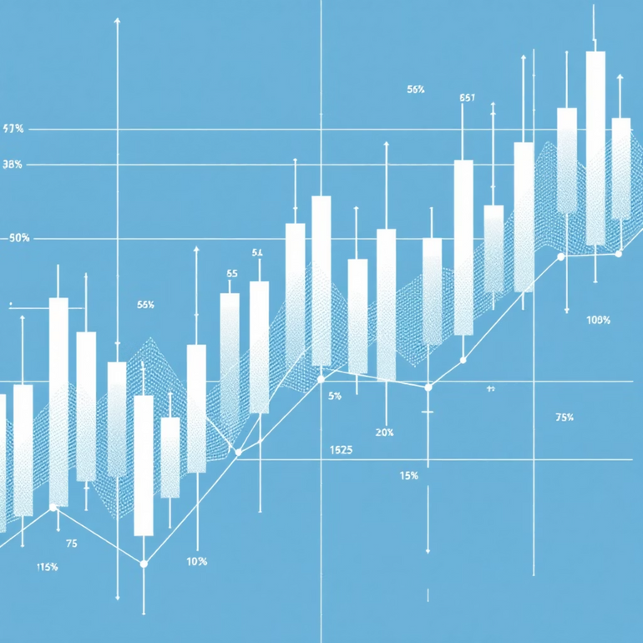
Data & Feature Engineering
Data Collection
Stock data is collected daily from Yahoo Finance, including Open, High, Low, Close, Volume, and Adjusted Close features.
Data Preprocessing
Convert date to datetime format.
Normalize numerical features.
Split into 80% training and 20% testing sets.
Notes:
5

Slide 6
The Relative Strength Index (RSI)
RSI is a crucial momentum oscillator (0 to 100) used as an additional feature to enhance prediction accuracy.
RSI > 70
Market is Overbought, suggesting a possible price correction or reversal.
RSI < 30
Market is Oversold, suggesting a possible upward trend or bounce.
The 14-day RSI is calculated and integrated into the model training process.
Notes:
6

Slide 7

Model Implementation & Comparison
We tested four distinct models to capture different aspects of the time series data.
1
Linear Regression
Used as a simple, interpretable baseline model.
2
Random Forest Regressor
Handles non-linearity and is used effectively with the RSI feature.
3
Decision Tree Regressor
Highly interpretable but carries a risk of overfitting the training data.
4
ARIMA
A dedicated time-series model that captures trends and seasonality without using RSI.
Notes:
7

Slide 8

Evaluation and Key Findings
Model performance was evaluated using the R² Score. Traditional ML models struggled due to inherent stock volatility.
-33.42
-2.85
-2.84
-2.83
Linear Regression
Random Forest
Decision Tree
ARIMA
Lowest performance, indicating poor fit to the volatile data.
Relatively better performance among the ML models tested.
Similar performance to Random Forest, but high risk of overfitting.
Best performance overall, capturing time-series trends effectively.
RSI successfully identifies overbought/oversold regions, making it more useful as a trading indicator than a pure price predictor.
Notes:
8

Slide 9

Web Application Features
The Flask application provides a user-friendly interface for real-time analysis and prediction.
Ticker Input
Allows users to enter any valid stock ticker symbol.
Price Chart Display
Interactive visualization of historical stock prices using Chart.js.
RSI Line Graph
Separate graph showing the 0–100 scale RSI for momentum analysis.
Next-Day Prediction
Displays the model's forecast for the subsequent trading day.
Notes:
9

Slide 10

Conclusion & Future Roadmap
The project successfully established a foundation for stock prediction, highlighting the value of technical indicators.
Current Success
Future Enhancements
RSI provides valuable market momentum insights, complementing the limited predictive power of traditional ML models.
Integrate deep learning models (LSTM/GRU), combine RSI with MACD/Bollinger Bands, and deploy on a cloud platform.
This work paves the way for advanced hybrid models combining technical analysis with deep learning for improved accuracy.
Notes:
10

